Slide 1


Slide 2
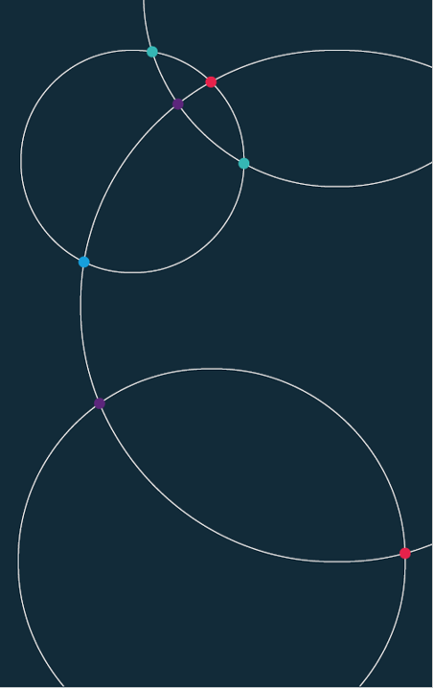
Data Science.
University of Bristol
Autumn 2021

Slide 3
Week 1.
Intro and plan. Team, learning objectives, resources, assessment.
What is Data Science? Data, insights and responsibilities.
Building blocks. HTML, CSS and JavaScript
Practical 1. Setting up your portfolio site.

Slide 4

Course Plan.

Slide 5
















Where we are.
Currently most analysts have five steps or more between their raw data and their output.
Example: a journalist or analyst making a chart of US GDP
Data source
Public-sector
aggregator
Commercial
aggregator
Analyst
Publisher
Output
JPEG
SVG
SVG
XLS
SVG
TXT
CSV
SVG
BLS
FRED
Bloomberg
Editorial dept
Web team
Note how this system works:
Many players. Some add delay, others add commercial cost. There are also significant in house manpower cost.
Error prone. Each link can, and does, break. Each one adds to the change of a human error.
Compatibility problems. Many different file types. Delay and compatibility problems
Data storage costs. Huge data storage requirement, with data stored in each silo along the way.
The result is a data system that is slow, costly and inaccurate.

Slide 6







Where we are going.
The modern approach we will teach you is different. The aim is to build a single secure channel linking an analyst’s output right back to the raw data.
Data source
Output
Analyst
BLS
Note the differences with the new system:
Auto-refresh. Your presentation is always up to date. When the raw data updates, it flows through the channel instantly and automatically.
Cost eradication. The number of players (and associated costs) collapses. There are no data silos – the data shown on the web site are the raw data, not a copy of them.
Auto-verification. The one-to-one link back to the original data provider means no fact check is needed.
The result is analysis that is faster, cheaper and more accurate.

Slide 7
Team.
Prof Richard Davies.
www.richarddavies.io
www.extremeeconomies.com
https://rdeconomist.github.io
Dr Denes Csala.
https://www.csaladen.es
Mr Charlie Meyrick.
https://meyrickcharlieecon.github.io

Slide 8
Learning objectives.
Data science (DS) theory and principles. An understanding of data, visualization.
DS skills. Skills including HTML, CSS, JavaScript, Python, Vega.
DS portfolio. A live web site that hosts (1) your DS portfolio and (2) your coursework.

Slide 9
Resources.
Key resource: demonstrations of code, chart examples, course plan:
www.rapidcharts.io
And: the repository behind this site:
https://github.com/RDeconomist/RDeconomist.github.io
In particular familiarise yourself with the following pages:
www.rapidcharts.io/datascience
www.rapidcharts.io/dashboards
www.rapidcharts.io/library
In addition, there is a course DropBox, holding PDFs of notes and examples of code:
Data Science DropBox

Slide 10
Weekly plan.
Monday 11:00-13:00: Lecture and practical.
Thursday 16:00-17:00: Project discussion.
Office Hours:
RD: Mon, 17:00-18:00
DC: Thu, 15:00-16:00
CM: Fri, 15:30-16:30

Slide 11
Assessment. {Deadline: 10th Jan 11am}
Coursework. The coursework consists of two parts.
DS Portfolio (20%). In each of the first 10 weeks you learn the steps to produce charts, tables or visualisations. These are worth 20% of your grade. Each week is graded equally, i.e. 2%. These should be completed during the week.
DS Project (80%).
Between 3 and 8 charts. Embedded in your site, hosted by GitHub pages.
An accompanying write-up (also embedded on your page) discussing:
the aims of your project;
the data you used, how you accessed it, including notes on automation/replication;
challenges in data cleaning and/or analysis, and the tools you used to overcome them;
your conclusions.
Each section must not exceed 200 words.

Slide 12
Steps to take immediately.
Economics Observatory. Sign up for our newsletter. We will be emphasising charts and data over coming months.
@RapidCharts on Instagram. We will post daily chart ideas, each with code, for the duration of the course. These will help with both your portfolio and project.

Slide 15

Building blocks.

Slide 16

Data science.

Slide 17
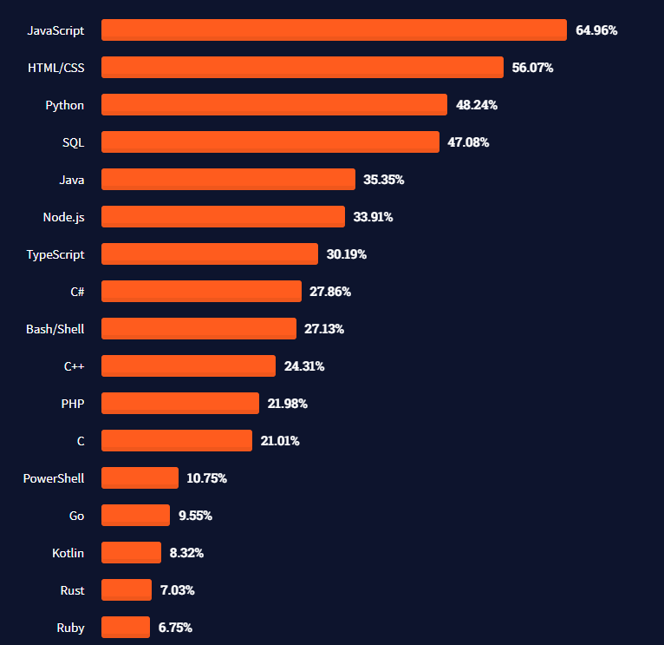
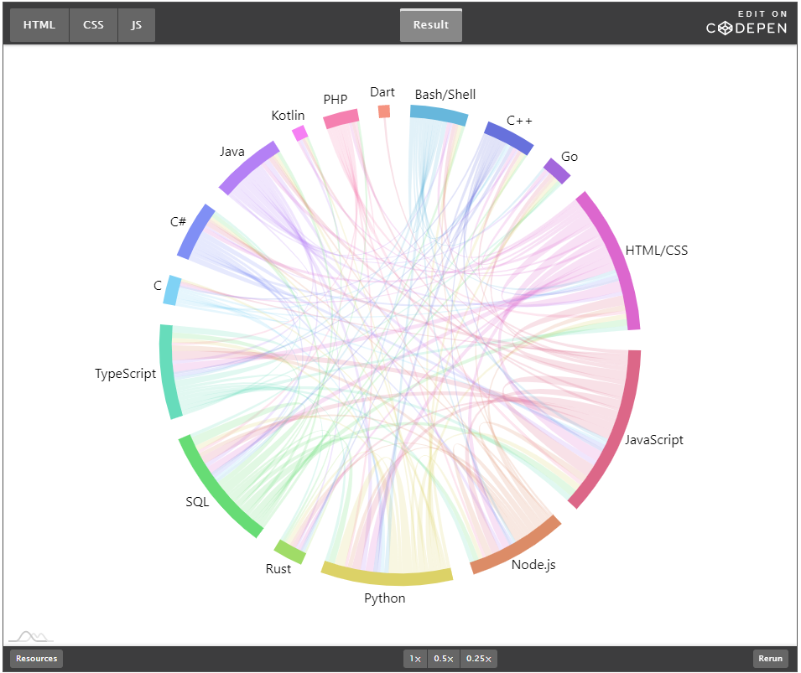
Most used languages, 2021.
https://insights.stackoverflow.com/survey/2021#technology-most-popular-technologies
https://stackoverflow.blog/2021/08/02/2021-stack-overflow-developer-survey-results/

Slide 18
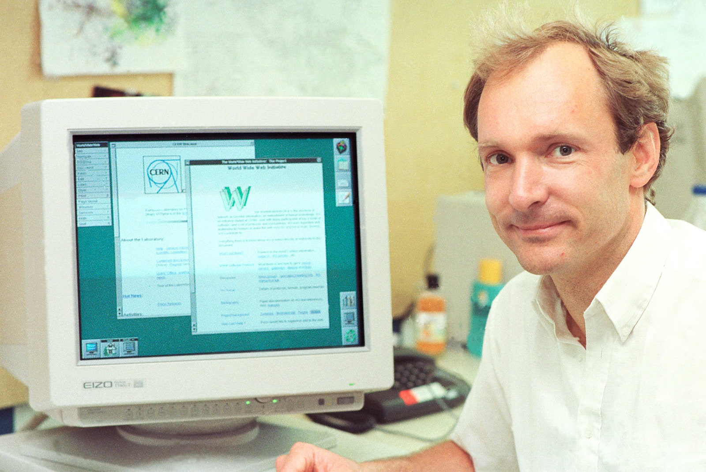
HTML.
HT. Hypertext.
As in http:// (Hypertext Transfer Protocol)
ML. Markup language
1993. Invented at CERN by Tim Berners-Lee.
1994. Dave Raggett (Hewlett Packard, Bristol), develops HTML+ and Arena browser.
1995. WC3 guidelines published, to end browser wars.
Big idea. The HT in the name is the big idea. There were lots of markup languages (SGML for example) but TBN idea was to link documents together, it added hyperlinks.
Tim Berners-Lee. Image: CERN
https://home.cern/science/computing/birth-web/short-history-web
https://www.vanityfair.com/news/2018/07/the-man-who-created-the-world-wide-web-has-some-regrets

Slide 19
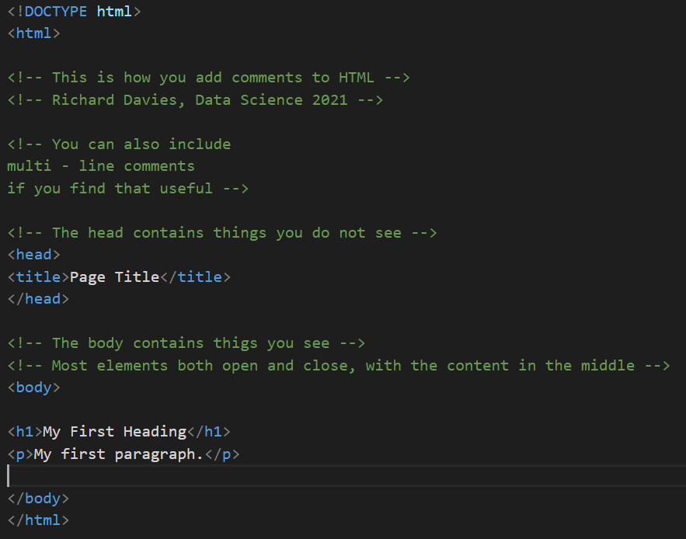
HTML example.

Slide 20
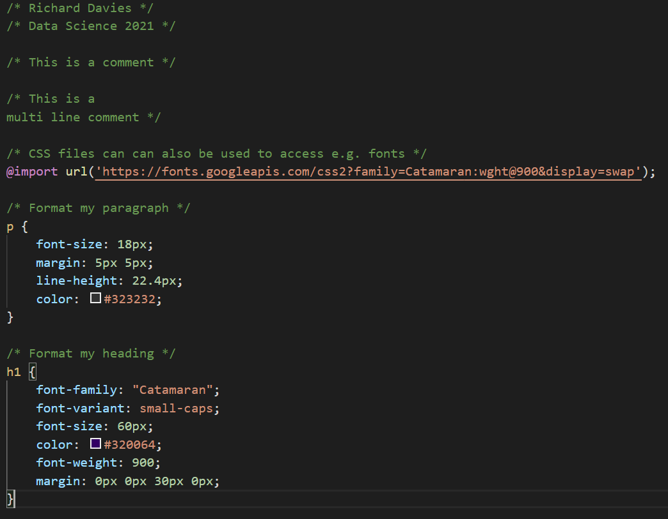

CSS.
Cascading Style Sheets
1994. First proposal – again at CERN.
Håkon Wium Lie, 12 December 1995
https://www.w3.org/Style/CSS20/history.html

Slide 21
Putting HTML and CSS together. To link your HTML page to a CSS file you specify the location in the head section of your page. <!-- Here is the head section --> <head> <title>Page Title</title> <!-- Link to my CSS file --> <link rel="stylesheet" href="firstExample.css"> </head> Your page will now have the styles set out in the CSS file.

Slide 22
JavaScript.
1995. JS launched by Netscape. Brief war with Microsoft before widespread adoption.
Brendan Eich. Key role in development of JS. Now used in almost all (>95%) of web sites.
Interactivity. JS allows us to make web sites interactive. Changing what the web site looks like and does in response to our choices.
In Data Science. Some uses of JS.
Fetching data. Grab data from another site, via an API, when you open you page.
Cleaning and manipulating data. Prepare and analyse the data for use in a chart or table.
Visualising data. Display the data in a way you wish. There are lots of charting “libraries” that do this. We will use two (Vega Lite and Charts.js).
Interactivity. Make visualisations interactive + sites fun and engaging.

Slide 23
JSON data.
JavaScript Object Notation. An important data type. Why use it?
It is the way computers share data.
Most importantly it is what many APIs will deliver – your data will arrive to you in this way.
It looks complicated at first, but is easy to convert into access, change and chart.
Formatted as key : value pairs (aka name : value pairs)
'{"name":“Richard", “kids":3, “team":“Manchester United”, “address”:null}’
Keys are strings, always in double quotes.
Values can be many things: string, number, arrays, objects.
Useful tools:
www.jsonlint.com. Test and format JSON.
JSON formatter. Chrome extension.

Slide 24
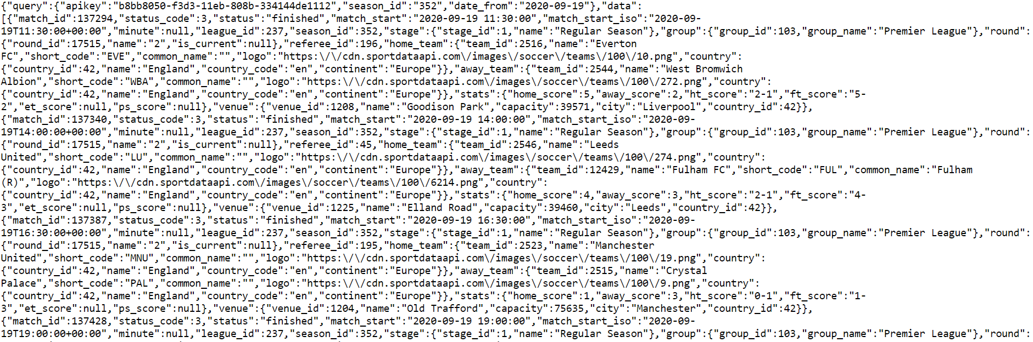
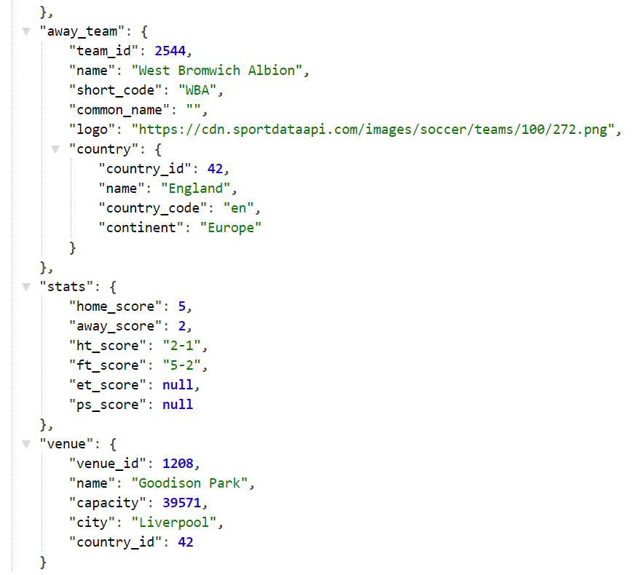
Raw.
Parsed.
API returns. The results of request to Sport Data API.

Slide 25
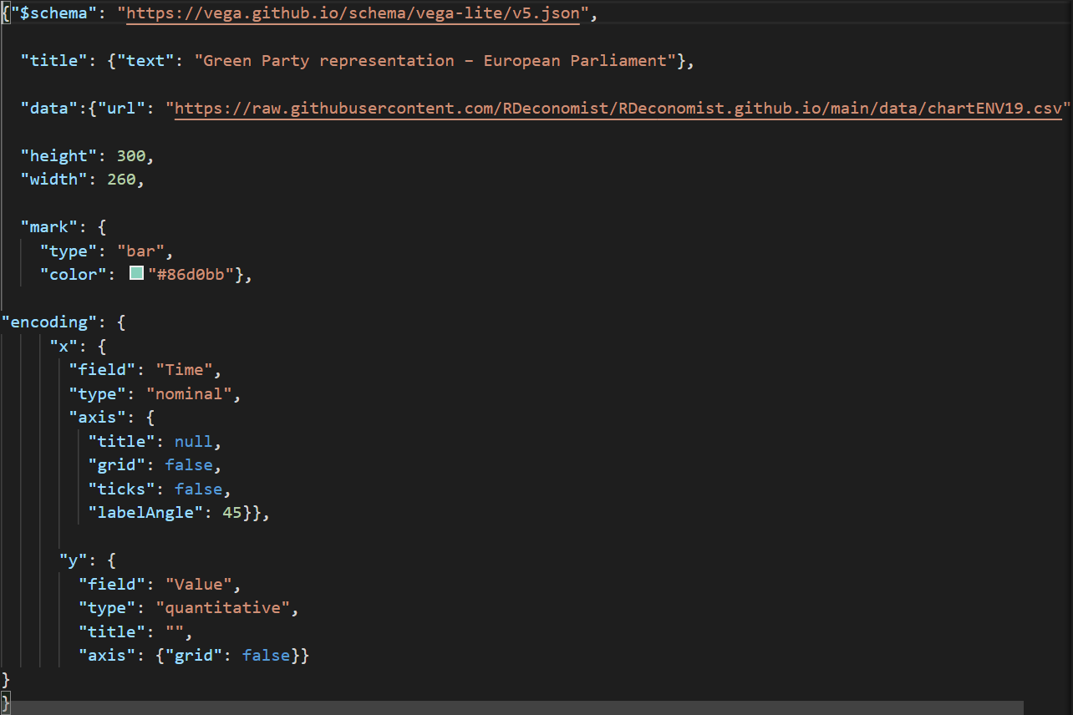
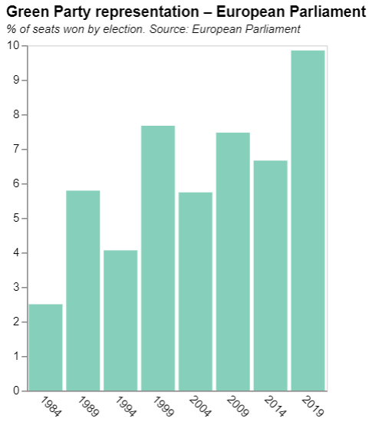
Charts as JSON.

Slide 27
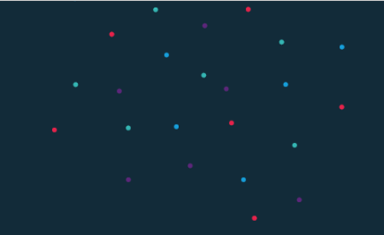
Practical 1.
Set up your GitHub pages site.
Enter your details HERE.
Embed first two charts in your page.

Slide 29
Data Science?
Notes:
Open-floor question on what IS data science?

Slide 30
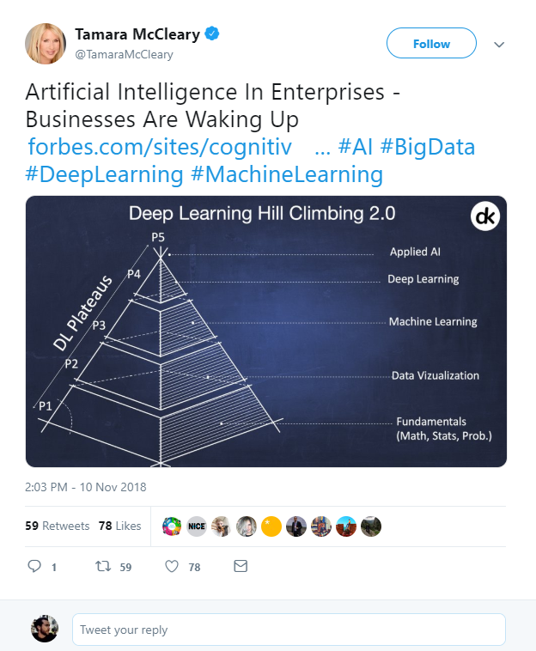

What is Data Science?
Artificial Intelligence?
Machine Learning?
Deep Learning?
Big Data?
https://twitter.com/TamaraMcCleary/status/1061197523610550272
Notes:
Tamara MCcleary – Tech Influencer
The data science pyramid
What do some of the more “fashionable” terms mean?
https://twitter.com/TamaraMcCleary/status/1061197523610550272

Slide 31

1 ZB zeta-exa-peta terra-giga-mega
Norhteastern, 2016
Notes:
In one year, humanity generates around 1ZB of data.
www.northeastern.edu/graduate/blog/how-much-data-produced-every-day/
If you take an average 10GB phone, that means 100 billion of phones.
If you take these phones and you stack them, screen to back, you could build one million 800m tall towers.
That is one Burj Khalifa for every pixel on this screen.

Slide 32
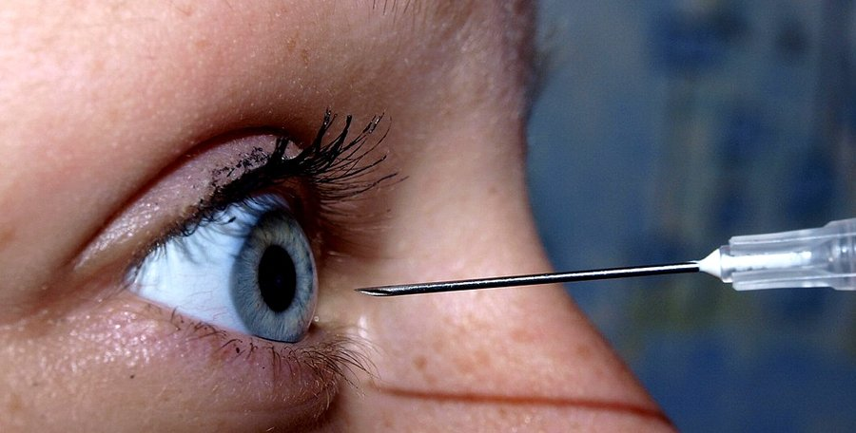
Attention ? At tension ?
Notes:
Data is practically infinite. But is your attention, too?

Slide 33


250 ms
Sabine Kastner et al., Princeton, 2018
Notes:
Sabine Kastner et al., Princeton, 2018
Your brain effectively has quarter of a second to decide what is important and what is not.

Slide 34

Attention poverty
"What information consumes is rather obvious: it consumes the attention of its recipients. Hence, a wealth of information creates a poverty of attention, and a need to allocate that attention efficiently among the overabundance of information sources that might consume it."
Herb Simon, as quoted by Hal Varian, Scientific American, 1995. Adapted from UW CSE442 and the original research by PARC UIR
Notes:
There is an overload of information.
We need a way to figure out what is important and what is not.

Slide 35
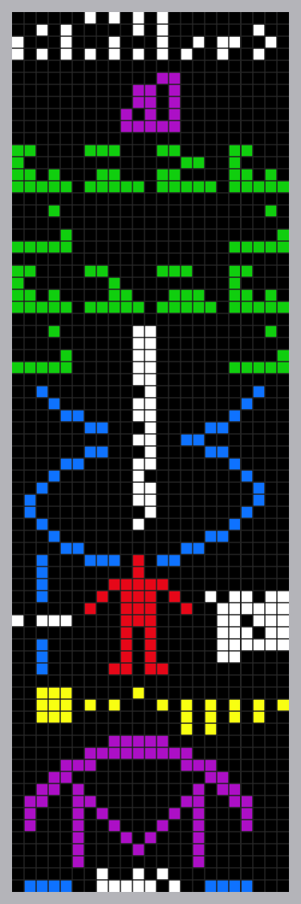


Data. Information. Knowledge.
Notes:
Arecibo message. This is data science. Find what’s important in a sea of data. That’s useful information. Put that information into context. That is knowledge.
In David McCandless’ book, Knowledge is Beautiful, something similar is the inner cover photo.
In this particular course, we will be dealing with the part of data science that you might call “Business Inteligence”.
This is exactly the Data->Information->Knowledge process.
https://www.datapine.com/blog/business-intelligence-for-small-business/

Slide 36
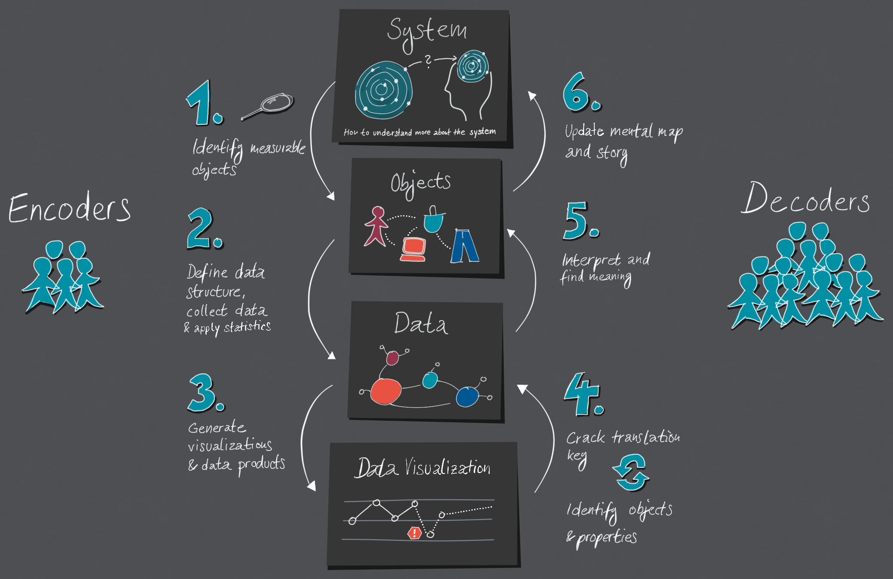

https://medium.com/nightingale/the-cycle-of-encoding-and-decoding-f3ff17010631
Notes:
Data visualisation is a language of conversing with data.
https://medium.com/nightingale/the-cycle-of-encoding-and-decoding-f3ff17010631

Slide 37
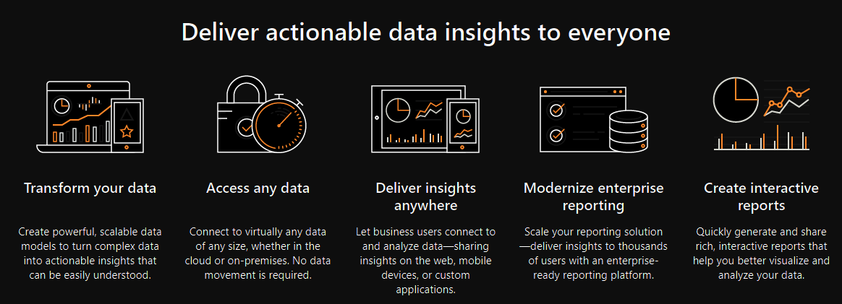
What is Data Science?
Microsoft, 2020
Notes:
Microsoft’s definition – probably the best in the industry

Slide 38
What is Data Science?
Data science combines the scientific method, math and statistics, specialized programming, advanced analytics, AI, and even storytelling to uncover and explain the business insights buried in data.
IBM, 2021
Notes:
IBM – probably the most formal
https://www.ibm.com/cloud/learn/data-science-introduction
Data science combines the scientific method, math and statistics, specialized programming, advanced analytics, AI, and even storytelling to uncover and explain the business insights buried in data.

Slide 39


Big Data. Big Responsibility.
The Datasaurus, Autodesk, Alberto Cairo, 2017
Notes:
So there is too much data, but our attention is limited.
The art is then to extract what is important from that huge pile of data.
Welcome to Data Science.

